Slide 1

Network and Computer Security
Retail: GrooveGalaxy
Group A16
João Leitão - 93088
Daniel Gomes - 99195
Simen Myrrusten - 108924
Project Advisor: David R. Matos
Project Evaluator: Miguel Filipe Leitão Pardal

Slide 2

Outline
Secure document
Message format
Architecture
Router rules
Security challenge
Conclusion

Slide 3
Secure document
Provided a single shared secret
Task: Provide authenticity and confidentiality
AES/CTR/NoPadding
AES recognized symmetric encryption
CTR enables parallel encoding
HMAC for authenticity

Slide 4
Message format
{Tag, {ProtectedDoc}_{Klt}, IV_{lt}}_{Ks}, IV_{s}
HMAC( {ProtectedDoc}_{Klt}, K_{lt})
Variables:
Ks = session key
Klt = Long-term key (initial shared secret)
IV_{lt} = IV used for CTR mode in the inner encryption
IV_{s} = IV used for CTR Mode in the outer encryption
HMAC() = the function creating the Tag.

Slide 5
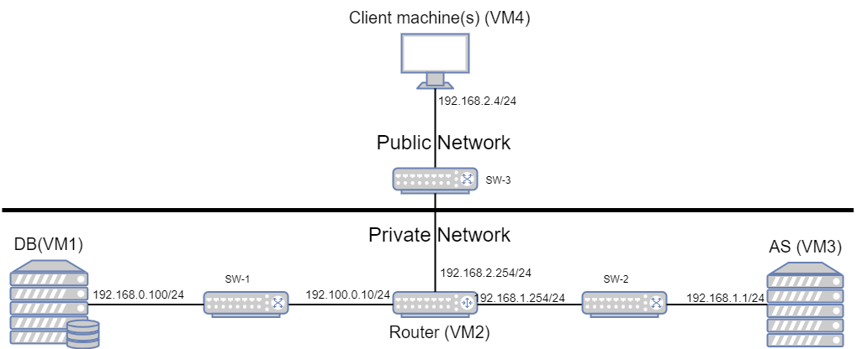
Architecture
Notes:
Communication between client machines and server is encrypted, while the database to server communication is sent in plaintext. As the data is non-sensitive and the networks are private this was not deemed necessary.

Slide 6
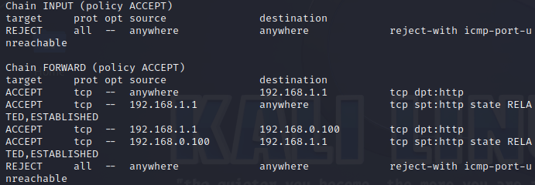
Router rules

Slide 7
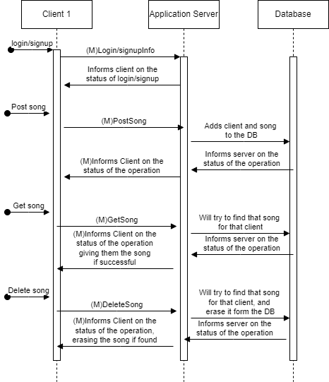

Slide 8
Security challenge
Fast decryption and family sharing
Use properties of CTR to encrypt certain parts at client side:
Select where you want to start in the song. Sections are the blocks of encryptions in CTR.
More user friendly adaptations could be implemented

Slide 9
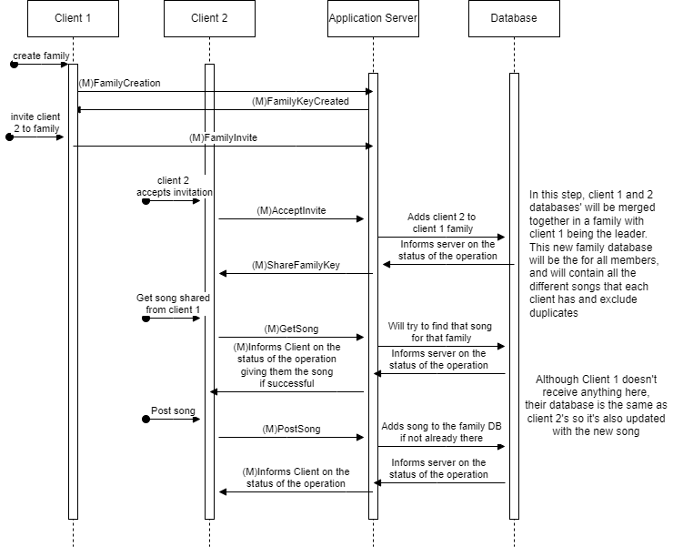
When a family key is introduced, it is used instead of the initial shared secret in the encryption.

Slide 10
Conclusion
Achievements:
Working application with client(s), application server and database.
Integrity
Authenticity
Restrictive access of private network
Family sharing
“Fast decryption”
Improvements:
User friendliness
HTTPS
Perfect forward secrecy
Replay attacks protection
Notes:
Working application with a simple CLI, application server and database. The user is able to do post, get and delete songs.
We have integrity created from the use of session keys, which are shared using the initial shared secret.
We have authenticity from the HMAC TAG, where the shared secret and message is used to create the TAG.
We have a firewall only allowing HTTP communication to the application server and between the AS and DB.
Family sharing where a new family key is generated and used such that a family can share songs, while still providing authenticity.
Fast decryption which allows a user to choose where it wants to start the song, and only decrypt the useful parts.
User friendliness could have been better, such as a web IF and smooth song playing. But this was not prioritized as this is a security course.
The lack of HTTPS means that we don’t have any machine authentication since no digital certificate is shared to the client. This leads to the possibility of impersonating the application server.
Perfect forward secrecy. Not a requirement in an application with non-sensitive data such as this, but nice to have. Could have been implemented using Diffie-Hellman key exchange.
Replay attack protection was not implemented. With the use of a timestamp, sequence number or challenge/response pattern this could have been implemented.

